Slide 1
Computer Generated Simulation In
Android Application
B.E Project
By
Aadarsh Jadhav
&
Rohit Kulkarni
Under the Guidance
Of
Prof. J.S NADAF

Slide 2
But, Why though?
Modern VR devices are expensive
For entertainment purposes
Future of mobile gaming industry
A need to prove

Slide 3
Things to keep in mind before starting
It’s for android
No heavy sculpted prefabs
Keep testing
Use planes instead of actual sculpted mesh walls prefabs
Reduce the Mesh Colliders
How many assets are needed
Use agile development model

Slide 4
Planning and Designing
Creating horror/puzzle games requires research on what the crucial part of getting scared is for humans.
Gathering the audio mp3 files required for the development.
Create Prefabs, texture materials, animations.
Lightning Effects

Slide 5
Softwares Used
Unity Game Engine
Blender
Premiere Pro
Adobe Photoshop

Slide 6
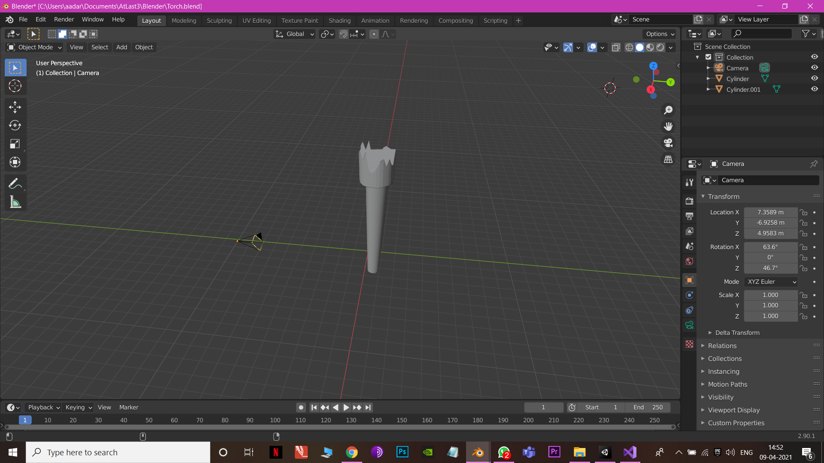
Insights
Fire Torch:

Slide 7
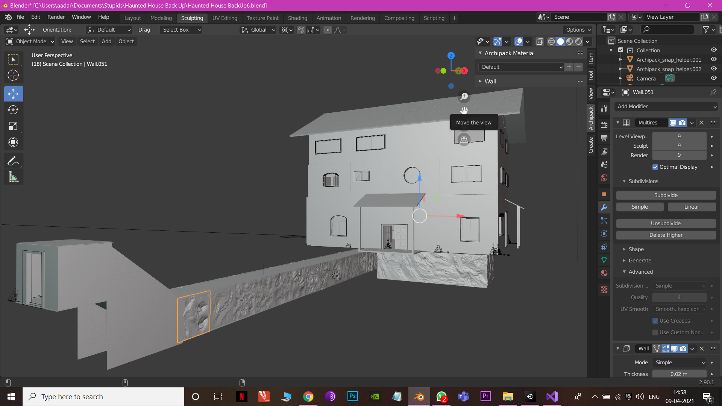
House:

Slide 8
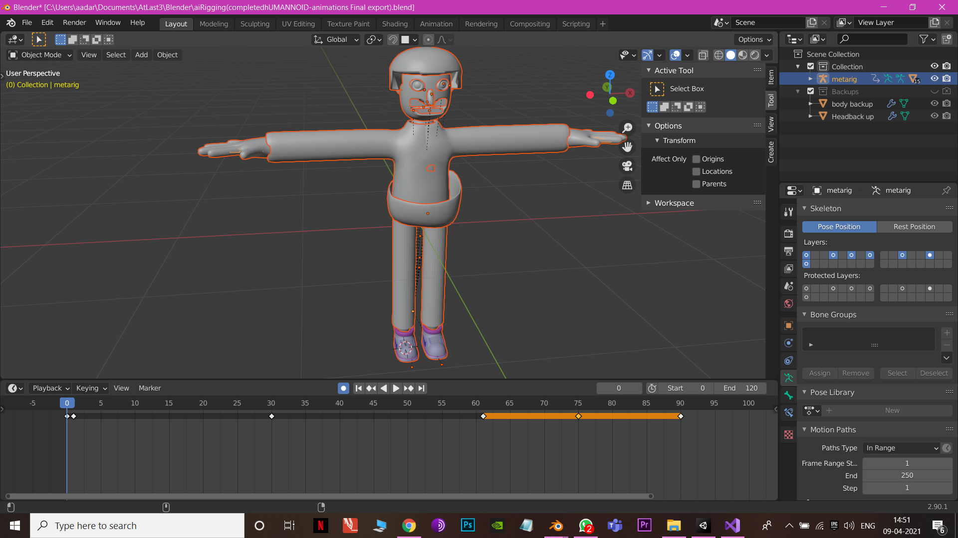
AI-NPC:

Slide 9
Why Google Cardboard SDK?
Currently, the only SDK for android
Daydream is only for certain phones
It makes easier to interact with objects using raycast system
Supports many devices

Slide 10
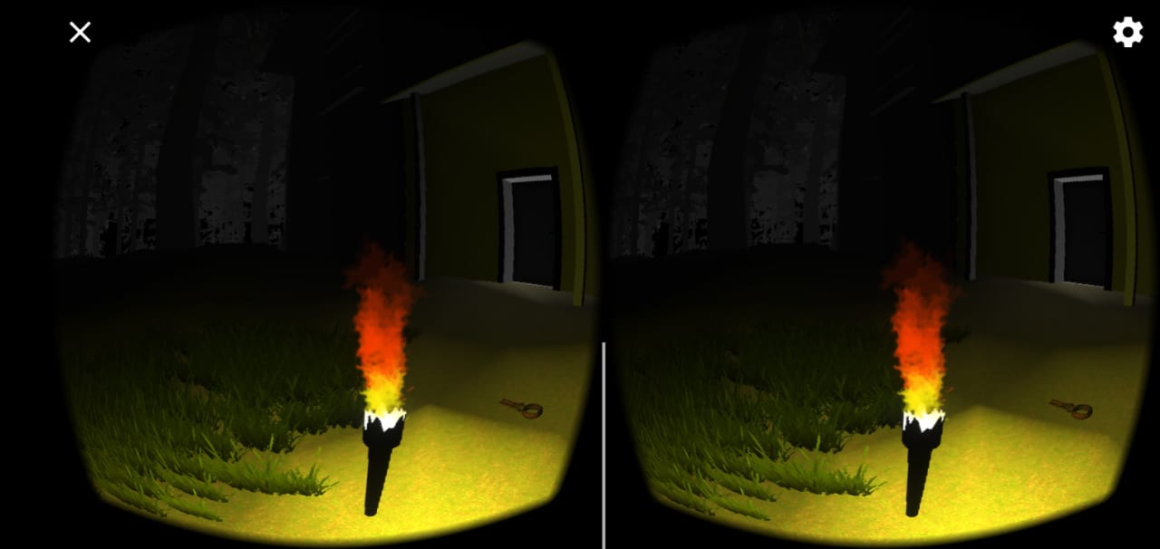
Future?

Slide 11
Thank you for your time!

